Slide 1
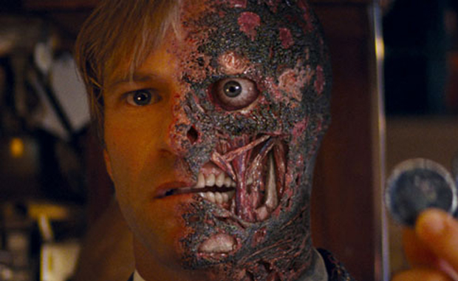
Title: Othello: Act 1 Sc 2 L.O: To identify changing character traits
Starter:
What is the name given to this famous character?
What traits would you associate with him?

Slide 2
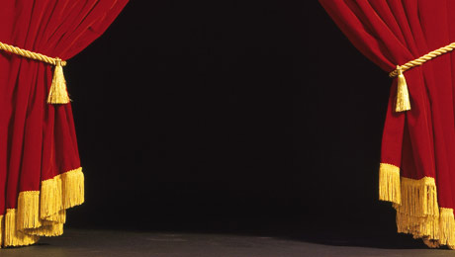
Let’s Read!
4 Characters
Iago
Othello
Cassio
Brabantio

Slide 3
Key points: Expand – in notes copy
Iago and Othello speak (lines 1-28)
Trouble in Cyprus (lines 29-54)
Brabantio confronts Othello (lines 55-61)
Do you think that Brabantio’s anger is justified and his speech reasonable given the way his daughter has just behaved?

Slide 4
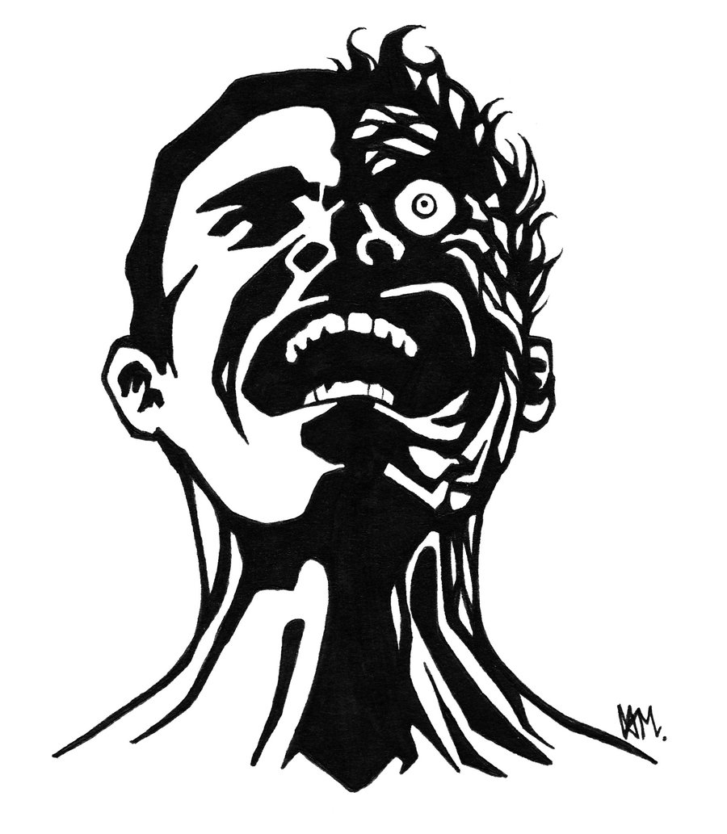
Activity:
Character Analysis
In your soft copy
Draw an outline of a face
Split it in two
Lable it ‘Iago’
On one side write the traits you associate with Iago in Act 1 Sc 1
On the other side label it Ac 1 Sc 2

Slide 5
Homework – in notes copy
How does the Othello we meet in this scene differ from the Othello described by Iago and Roderigo in the opening scene. (P.Q.E 10 sentences +)
What props do you need for this scene? What atmosphere do they create? (6+ sentences)

Slide 6
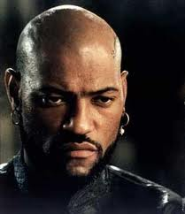
Title: Focusing on the character - Othello L.O: To identify changing character traits
Starter:
What are your first impressions of Othello?
Do you like him? Why/why not?

Slide 7
Key points expanded – in notes copy
Iago tells Othello:
That Roderigo has been saying unpleasant things about him
That Brabantio now knows of his marriage to Desdemona
Othello says:
Nothing to be ashamed of
His good character will ensure that the senator cannot harm him

Slide 8
Othello
Dignity
Pride
Add 2 words
Add evidence

Slide 9
Title: Othello: Act 1 Sc 2 L.O: To identify changing character traits
Plenary:
How will you expect Othello to behave in scene 3?
Which character is the most entertaining? Why/how?

Slide 10
Homework
Give your impression of Brabantio’s attitudes as the emerge in this scene. Can you find anything to say in favour of Brabantio?
(10 sentences+)
Feel free to compare/contrast your impressions between scene one and two.

